Slide 1
Event-Driven Microservices
Patterns

Slide 2
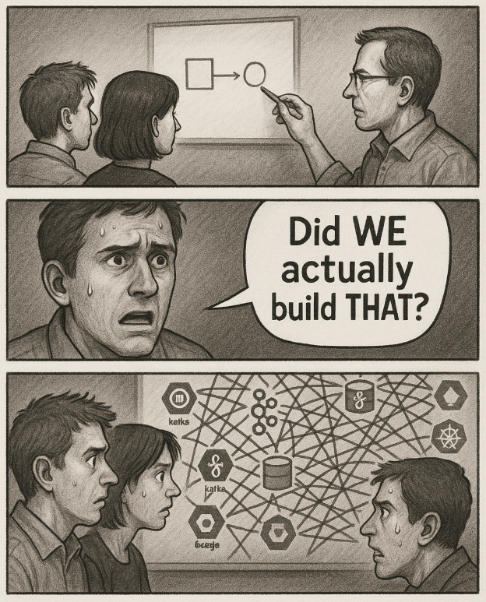
race conditions
tight coupling & low cohesion
out-of-order messages
increasingly harder
to add new services
lost messages
& data inconsistencies
complex error handling
duplicate
messages

Slide 3
Event-Driven Microservices - Patterns
🟩 Architectural Styles
🟩 Orchestration
🟩 Choreography
🟩 Dual Write Problem
🟩 Outbox Pattern
🟩 Inbox Pattern

Slide 4
Architectural Styles
A software architectural style is a general way to design a system:
specifies how components are organized,
how they interact,
and the constraints on those interactions

Slide 5
Event-Driven Microservices - Patterns
✅ Architectural Styles
🟩 Orchestration
🟩 Choreography
🟩 Dual Write Problem
🟩 Outbox Pattern
🟩 Inbox Pattern

Slide 6
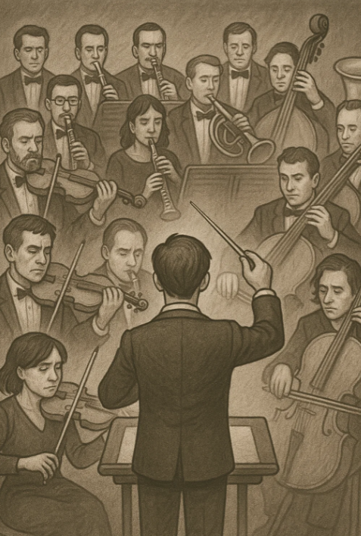
Orchestration
One central component (the orchestrator) controls and coordinates other components.
It tells each component what to do and when
The other components just follow instructions; they don’t talk directly to each other.

Slide 7
Orchestration
Order Service
E-Commerce Orchestrator
Inventory Service

Slide 8
Orchestration
Order Service
place.order
E-Commerce Orchestrator
Inventory Service

Slide 9
Orchestration
Order Service
place.order
E-Commerce Orchestrator
Inventory Service
update.stock

Slide 10
Orchestration
Order Service
✅Simpler Error Handling
place.order
E-Commerce Orchestrator
Inventory Service
update.stock

Slide 11
Orchestration
Order Service
✅Simpler Error Handling
place.order
E-Commerce Orchestrator
Inventory Service
update.stock
❌
out of stock

Slide 12
Orchestration
Order Service
✅Simpler Error Handling
place.order
E-Commerce Orchestrator
cancel.order
Inventory Service
update.stock
❌
out of stock

Slide 13
Orchestration
Order Service
✅Simpler Error Handling
✅The components are independent from each other
place.order
E-Commerce Orchestrator
Inventory Service
update.stock

Slide 14
Orchestration
Order Service
✅Simpler Error Handling
✅The components are independent from each other
place.order
E-Commerce Orchestrator
Inventory Service
update.stock

Slide 15
Orchestration
Order Service
✅Simpler Error Handling
✅The components are independent from each other
❌ The orchestrator depends on all the other components
place.order
E-Commerce Orchestrator
Inventory Service
update.stock

Slide 16
Orchestration
Order Service
✅Simpler Error Handling
✅The components are independent from each other
❌ The orchestrator depends on all the other components
place.order
E-Commerce Orchestrator
Inventory Service
update.stock
Shipping Service

Slide 17
Orchestration
Order Service
✅Simpler Error Handling
✅The components are independent from each other
❌ The orchestrator depends on all the other components
place.order
E-Commerce Orchestrator
Inventory Service
update.stock
deliver.products
Shipping Service

Slide 18
Orchestration
Order Service
✅Simpler Error Handling
✅The components are independent from each other
❌ The orchestrator depends on all the other components
❌ Harder to implements new components
place.order
E-Commerce Orchestrator
Inventory Service
update.stock
deliver.products
Shipping Service

Slide 19
Event-Driven Microservices Patterns
✅ Architectural Styles
✅ Orchestration
🟩 Choreography
🟩 Dual Write Problem
🟩 Outbox Pattern
🟩 Inbox Pattern

Slide 20
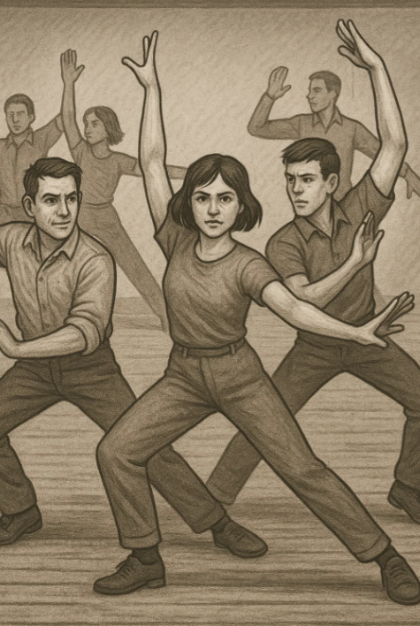
Choreography
A pattern where each service reacts to events on its own, without a central controller:
Each service decides what to do when it receives an event.
The overall workflow emerges from the interaction between services.

Slide 21
Choreography
Shipping Service
product.shipped
Order Service
stock.reserved
Inventory Service
order.placed

Slide 22
Choreography
Shipping Service
❌ Harder to implements error handling
product.shipped
Order Service
stock.reserved
Inventory Service
order.placed

Slide 23
Choreography
Shipping Service
❌ Harder to implements error handling
product.shipped
Order Service
stock.reserved
Inventory Service
order.placed
stock.unavailable

Slide 24
Choreography
Shipping Service
✅Simpler to implement new components
❌ Harder to implements error handling
product.shipped
Order Service
stock.reserved
Inventory Service
order.placed
stock.unavailable

Slide 25
Choreography
Shipping Service
✅Simpler to implement new components
❌ Harder to implements error handling
product.shipped
Order Service
stock.reserved
Inventory Service
order.placed
stock.unavailable
Stock Replenishment Service

Slide 26
Choreography
Choreography
Shipping Service
✅Simpler to implement new components
✅Scales Better
❌ Harder to implements error handling
product.shipped
Order Service
stock.reserved
Inventory Service
order.placed
stock.unavailable
Stock Replenishment Service

Slide 27
Choreography
Choreography
Shipping Service
✅Simpler to implement new components
✅Scales Better
❌ Harder to implements error handling
❌Cyclic Dependencies are possible
product.shipped
Order Service
stock.reserved
Inventory Service
order.placed
stock.unavailable
Stock Replenishment Service

Slide 28
Orchestration vs Choreography

Slide 29
Orchestration vs Choreography

Slide 30
Orchestration vs Choreography

Slide 31
Orchestration vs Choreography

Slide 32
Event-Driven Microservices Patterns
✅ Architectural Styles
✅ Orchestration
✅ Choreography
🟩 Dual Write Problem
🟩 Outbox Pattern
🟩 Inbox Pattern

Slide 33
Dual Write Problem
“write” = any operation that modifies data
saving / updating the DB
publishing a message to a message broker
sending a HTTP POST/PUT request
updating a file on the file system …
reading a message from the message broker ? 🤔 => committing the offers / ack the message

Slide 34
Dual Write Problem
orderRepository
.save( orderEntity )
messagePublisher
.send( orderCreatedEvt )

Slide 35
Dual Write Problem
orderRepository
.save( orderEntity )
messagePublisher
.send( orderCreatedEvt )

Slide 36
Dual Write Problem
orderRepository
.save( orderEntity )
messagePublisher
.send( orderCreatedEvt )

Slide 37
Dual Write Problem
orderRepository
.save( orderEntity )
✅
messagePublisher
.send( orderCreatedEvt )

Slide 38
Dual Write Problem
orderRepository
.save( orderEntity )
✅
messagePublisher
.send( orderCreatedEvt )

Slide 39
Dual Write Problem
orderRepository
.save( orderEntity )
✅
messagePublisher
.send( orderCreatedEvt )
❌

Slide 40
Dual Write Problem
At Most Once Delivery: a message is sent at most one time — it may be lost, but it won’t be delivered more than once.
+ No duplicates - Possible message loss
orderRepository
.save( orderEntity )
✅
messagePublisher
.send( orderCreatedEvt )
❌

Slide 41
Dual Write Problem
At Most Once Delivery: a message is sent at most one time — it may be lost, but it won’t be delivered more than once.
+ No duplicates - Possible message loss
At Least Once Delivery: a means a message is sent one or more times — it’s guaranteed to arrive, but might be delivered more than once.
- Possible duplicates + No message loss
orderRepository
.save( orderEntity )
✅
messagePublisher
.send( orderCreatedEvt )
❌

Slide 42
Dual Write Problem
orderRepository
.save( orderEntity )
messagePublisher
.send( orderCreatedEvt )

Slide 43
Dual Write Problem
@Transactional
orderRepository
.save( orderEntity )
messagePublisher
.send( orderCreatedEvt )

Slide 44
Dual Write Problem
@Transactional
orderRepository
.save( orderEntity )
✅
messagePublisher
.send( orderCreatedEvt )
❌

Slide 45
Dual Write Problem
@Transactional
orderRepository
.save( orderEntity )
✅
( rollback )
messagePublisher
.send( orderCreatedEvt )
❌
// rollback transaction

Slide 46
Dual Write Problem
@Transactional
orderRepository
.save( orderEntity )
❌
( rollback )
messagePublisher
.send( orderCreatedEvt )
❌
// rollback transaction

Slide 47
Dual Write Problem
@Transactional
orderRepository
.save( orderEntity )
messagePublisher
.send( orderCreatedEvt )

Slide 48
Dual Write Problem
@Transactional
orderRepository
.save( orderEntity )
✅
messagePublisher
.send( orderCreatedEvt )

Slide 49
Dual Write Problem
@Transactional
orderRepository
.save( orderEntity )
✅
messagePublisher
.send( orderCreatedEvt )
✅

Slide 50
Dual Write Problem
@Transactional
orderRepository
.save( orderEntity )
✅
messagePublisher
.send( orderCreatedEvt )
✅
// commit transaction

Slide 51
Dual Write Problem
@Transactional
orderRepository
.save( orderEntity )
✅
messagePublisher
.send( orderCreatedEvt )
✅
// commit transaction
❌

Slide 52
Dual Write Problem
@Transactional
orderRepository
.save( orderEntity )
✅
messagePublisher
.send( orderCreatedEvt )
✅
// commit transaction
❌

Slide 53
Dual Write Problem
@Transactional
orderRepository
.save( orderEntity )
❌
( rollback )
messagePublisher
.send( orderCreatedEvt )
✅
// commit transaction
❌

Slide 54
Dual Write Problem
The dual write problem occurs when we need to update two different systems atomically. For instance:
DB + Message Broker (save to DB & publish a message)
Message Broker + DB (consume/ack a message & save to DB)
DB + HTTP Request (save to DB & send a HTTP request)
Message Broker + Message Broker (consume from one broker and publish to another - say Active MQ -> Kafka)
DB + DB (eg. save to to different databases - say Mongo & Oracle)
… etc.

Slide 55
Event-Driven Microservices Patterns
✅ Architectural Styles
✅ Orchestration
✅ Choreography
✅ Dual Write Problem
🟩 Outbox Pattern
🟩 Inbox Pattern

Slide 56
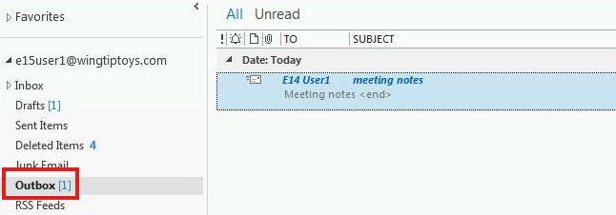
Outbox Pattern

Slide 57
Outbox Pattern
save orderEntity
to the order table
orders
publish the event
order.created

Slide 58
Outbox Pattern
save orderEntity
to the order table
orders
publish the event
order.created

Slide 59
Outbox Pattern
save orderEntity
to the order table
orders
save orderCreatedEvent to the an outbox table
outbox
publish the event
order.created

Slide 60
Outbox Pattern
@Transactional
save orderEntity
to the order table
orders
save orderCreatedEvent to the an outbox table
outbox
publish the event
order.created

Slide 61
Outbox Pattern
@Transactional
save orderEntity
to the order table
@Scheduled (or CDC)
orders
pull unpublished entries
from the outbox table
save orderCreatedEvent to the an outbox table
outbox
publish the event
order.created

Slide 62
Outbox Pattern
@Transactional
save orderEntity
to the order table
@Scheduled (or CDC)
orders
pull unpublished entries
from the outbox table
save orderCreatedEvent to the an outbox table
outbox
publish the event
order.created
update the outbox table
mark the event as published

Slide 63
Outbox Pattern
@Transactional
save orderEntity
to the order table
@Scheduled (or CDC)
orders
pull unpublished entries
from the outbox table
save orderCreatedEvent to the an outbox table
outbox
publish the event
❌
order.created
update the outbox table
mark the event as published

Slide 64
Outbox Pattern
@Transactional
save orderEntity
to the order table
@Scheduled (or CDC)
orders
pull unpublished entries
from the outbox table
save orderCreatedEvent to the an outbox table
outbox
publish the event
✅
order.created
update the outbox table
mark the event as published

Slide 65
Outbox Pattern
@Transactional
save orderEntity
to the order table
@Scheduled (or CDC)
orders
pull unpublished entries
from the outbox table
save orderCreatedEvent to the an outbox table
outbox
publish the event
✅
order.created
❌
update the outbox table
mark the event as published

Slide 66
Outbox Pattern
@Transactional
save orderEntity
to the order table
@Scheduled (or CDC)
orders
pull unpublished entries
from the outbox table
save orderCreatedEvent to the an outbox table
outbox
publish the event
✅✅
order.created
❌
update the outbox table
mark the event as published

Slide 67
Outbox Pattern
@Transactional
save orderEntity
to the order table
@Scheduled (or CDC)
// message headers:
orders
pull unpublished entries
from the outbox table
{
“idempotencyKey”: uuid,
“observedAt”: …
}
save orderCreatedEvent to the an outbox table
outbox
publish the event
✅✅
order.created
idempotency_key = uuid
observed_at = … (instant)
❌
update the outbox table
mark the event as published

Slide 68
Outbox Pattern
✅ Eventual Consistency
(At Least once delivery)
@Transactional
save orderEntity
to the order table
@Scheduled (or CDC)
// message headers:
orders
pull unpublished entries
from the outbox table
{
“idempotencyKey”: uuid,
“observedAt”: …
}
save orderCreatedEvent to the an outbox table
outbox
publish the event
✅✅
order.created
idempotency_key = uuid
observed_at = … (instant)
❌ Can add extra latency
❌ Can result in duplicate messages
❌
update the outbox table
mark the event as published

Slide 69
Event-Driven Microservices Patterns
✅ Architectural Styles
✅ Orchestration
✅ Choreography
✅ Dual Write Problem
✅ Outbox Pattern
🟩 Inbox Pattern

Slide 70
Inbox Pattern
invoke business logic
order.created
✉️

Slide 71
Inbox Pattern
order.created
invoke business logic

Slide 72
Inbox Pattern
save messages
to the inbox table
order.created
✉️
inbox
invoke business logic

Slide 73
Inbox Pattern
@Scheduled (or CDC)
pull unprocessed entries
from the inbox table
save messages
to the inbox table
order.created
✉️
inbox
invoke business logic
update the inbox table
mark the event as processed

Slide 74
Inbox Pattern
@Scheduled (or CDC) @Transactional
pull unprocessed entries
from the inbox table
save messages
to the inbox table
order.created
✉️
inbox
invoke business logic
update the inbox table
mark the event as processed

Slide 75
Inbox Pattern
@Scheduled (or CDC) @Transactional
// message headers:
{
“idempotencyKey”: abc-123…
“observedAt”: 1757265210
}
pull unprocessed entries
from the inbox table
save messages
to the inbox table
order.created
✉️
inbox
invoke business logic
update the inbox table
mark the event as processed

Slide 76
Inbox Pattern
@Scheduled (or CDC) @Transactional
// message headers:
unique constraint (idempotency_key)
{
“idempotencyKey”: abc-123…
“observedAt”: 1757265210
}
pull unprocessed entries
from the inbox table
save messages
to the inbox table
order.created
✉️
inbox
invoke business logic
update the inbox table
mark the event as processed

Slide 77
Inbox Pattern
@Scheduled (or CDC) @Transactional
// message headers:
unique constraint (idempotency_key)
{
“idempotencyKey”: abc-123…
“observedAt”: 1757265210
}
pull unprocessed entries
from the inbox table
save messages
to the inbox table
order.created
✉️
inbox
invoke business logic
✅ Handle duplicate messages (via idempotency_key)
update the inbox table
mark the event as processed

Slide 78
Inbox Pattern
select * from inbox where
status = ‘unprocessed’
order by observed_at desc
@Scheduled (or CDC) @Transactional
// message headers:
unique constraint (idempotency_key)
{
“idempotencyKey”: abc-123…
“observedAt”: 1757265210
}
pull unprocessed entries
from the inbox table
save messages
to the inbox table
order.created
✉️
inbox
invoke business logic
✅ Handle duplicate messages (via idempotency_key)
update the inbox table
mark the event as processed

Slide 79
Inbox Pattern
select * from inbox where
status = ‘unprocessed’
order by observed_at desc
@Scheduled (or CDC) @Transactional
// message headers:
unique constraint (idempotency_key)
{
“idempotencyKey”: abc-123…
“observedAt”: 1757265210
}
pull unprocessed entries
from the inbox table
save messages
to the inbox table
order.created
✉️
inbox
invoke business logic
retryable exceptions will leave
the inbox record
in ‘unprocessed’ status
update the inbox table
mark the event as processed
✅ Handle duplicate messages (via idempotency_key)

Slide 80
Inbox Pattern
select * from inbox where
status = ‘unprocessed’
order by observed_at desc
@Scheduled (or CDC) @Transactional
// message headers:
unique constraint (idempotency_key)
{
“idempotencyKey”: abc-123…
“observedAt”: 1757265210
}
pull unprocessed entries
from the inbox table
save messages
to the inbox table
order.created
✉️
inbox
invoke business logic
retryable exceptions will leave
the inbox record
in ‘unprocessed’ status
update the inbox table
mark the event as processed
✅ Handle duplicate messages (via idempotency_key)
✅ Handle out-of-order messages (via observed_at & retryable exceptions)

Slide 81
Event-Driven Microservices Patterns
✅ Architectural Styles
✅ Orchestration
✅ Choreography
✅ Dual Write Problem
✅ Outbox Pattern
✅ Inbox Pattern

Slide 82
Data Consistency Problems
Architectural Problems
race conditions
tight coupling & low cohesion
out-of-order messages
increasingly harder
to add new components
lost messages
& data inconsistencies
complex error handling
duplicate
messages

Slide 83
Architectural Styles: specify how components interact & their constraints.
Data Consistency Patterns: strategies for reliable data updates across boundaries
Orchestration
centralized control
explicit error handling
Choreography
high decoupling
evolutionary architecture
Outbox Pattern
eventual consistency (guarantees at least once delivery)
Inbox Pattern
handles out-of-order messages
handles duplicate messages

